Slide 1
Medicine Platter with Encoder
By William Denson

Slide 2
Four Step Approach – 4.2
Step 1: Defining the Problem
Healthcare is of primary importance when it comes to the modern world. Keeping track of medicine for patients on medications are needed and an accurate encoder is needed for rotating machinery.

Slide 3
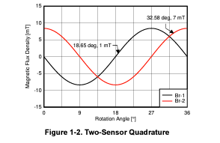
Fig. 1 – Texas Instruments (TI) provides numerous diagrams for encoder and hall effect sensors. This specific photograph shows rotation angles and according sine waves where peaks and troughs may be counted.

Slide 4
Four Step Approach – 4.2
Step 2: Simplifying along with initial designs the problem
A simple ground plane made of aluminum was hot glued to the bottom of the medicine platter
More elaborate designs were used for the medicine platter shape

Slide 5
Four Step Approach – 4.2
Step 3: Two main iterations were performed for improvements to the project.
The first project iteration used a one speed setup from the motorized pinwheel project
The second project iteration utilized the Zoetrope project and accompanying potentiometer and IC chip to control variable speeds to better control the medicine platter

Slide 6
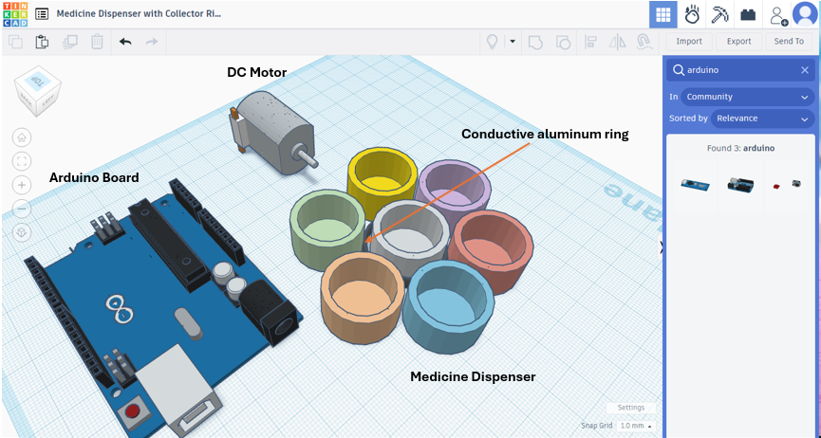
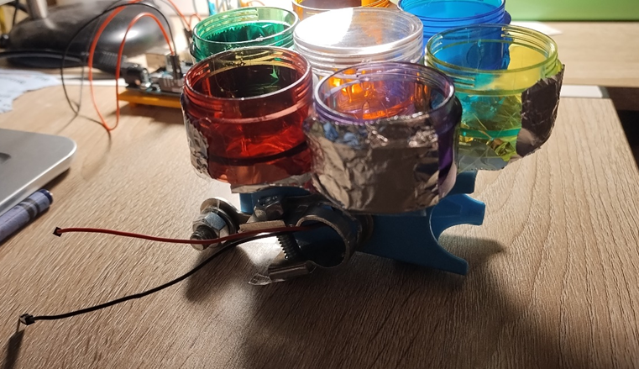
Four Step Approach – 4.2
Step 4: Verification
A blue LED will light up to verify continuity between the capacitance circuit
Each completed circuit will count as one platter advanced to the next platter. This would enable a patient to see how many times a pill has been taken
Model verification was used between the drafted Tinkercad model and the semi-assembled phase of the project

Slide 7
Technical Report
Executive summary: Several analog and digital pins were used in conjunction with each other to incorporate two difference Arduino projects into one. Coding efforts included managing pins to appropriate I/O ports
The following technical report implements engineering communication techniques that support the executive summary. This project provides the opportunity for engineers to market useful electrical engineering concepts to the public
Improvements to the design include using carbon brushes for stability of conductivity on a rotating object

Slide 8
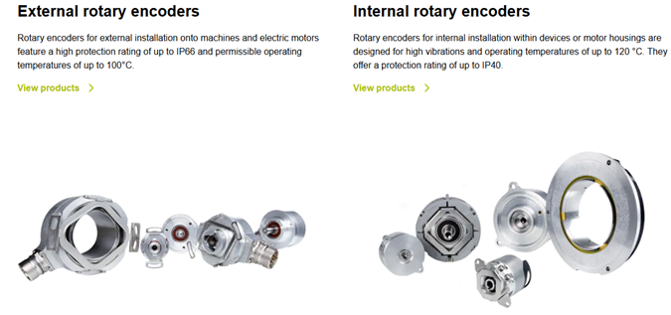
Morality Report
Accurate encoders are needed in the electrical and manufacturing fields of science to provide precise data to keep track of. This could prevent fraud and places an emphasis on engineering morality and Biblical standards. Further support is gathered by the National Society of Professional Engineers for morality guidelines including maintaining safety and accountability in the machines engineers build (Moaveni, 2016, p. 127)
https://www.heidenhain.com/products/rotary-encoders

Slide 9
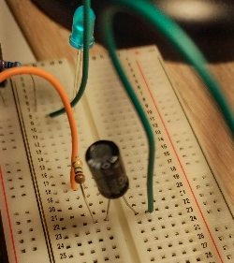
Engineering Effort
This project was uplifting and challenging, allowing me to cross reference different projects at a time while managing numerous jumpers across the integrated chips available in the Arduino kit requiring a good understanding of reading schematics. Experimenting with a capacitor helped smooth out signals used for the capacitance in the circuit but this depended on certain iterations throughout the project that involved placement on initial tests using the breadboard. Challengers were overcome during the coding phase by organizing global and constant variables

Slide 10
Works Cited
Moaveni, S. (2016). Engineering Fundamentals - An Introduction to Engineering. Cengage.
https://www.ti.com/lit/pdf/sbaa449
https://www.heidenhain.com/products/rotary-encoders

